Slide 1

Pet Adoption
By Daniel Pivonka, Brianne Bindas, and Scott Melo

Slide 2
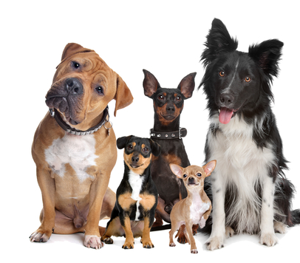
Project Goal
Connect users to a database of over 300,000 pets up for adoption
Use our search feature to find your perfect pet
View pet profiles and pictures
Add pets to your favorites so you don’t lose track of the pet you want
Help more pets get adopted!

Slide 3
Project Features
Pet Search Functionality
Display list of pets that match search
View pet profile and pictures
Favorites database to store pets your thinking of adopting

Slide 4
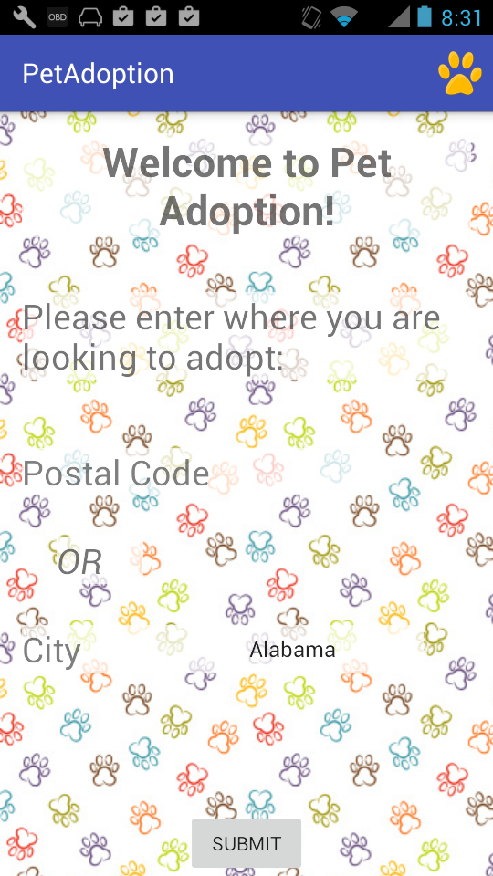
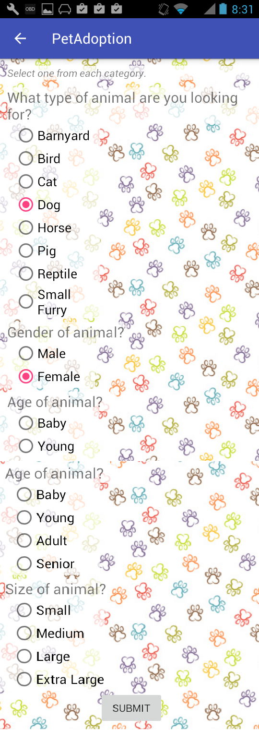
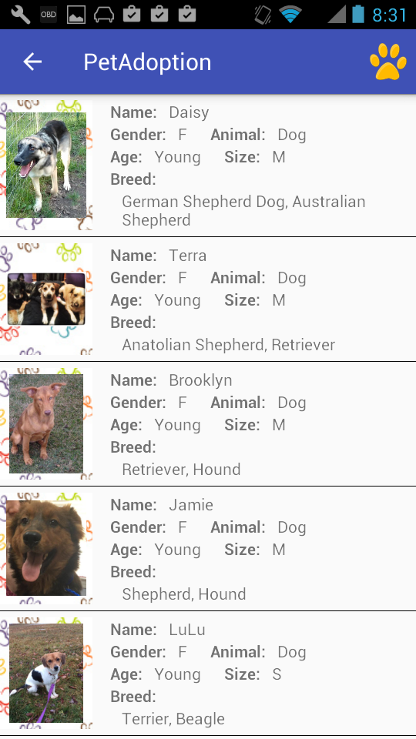
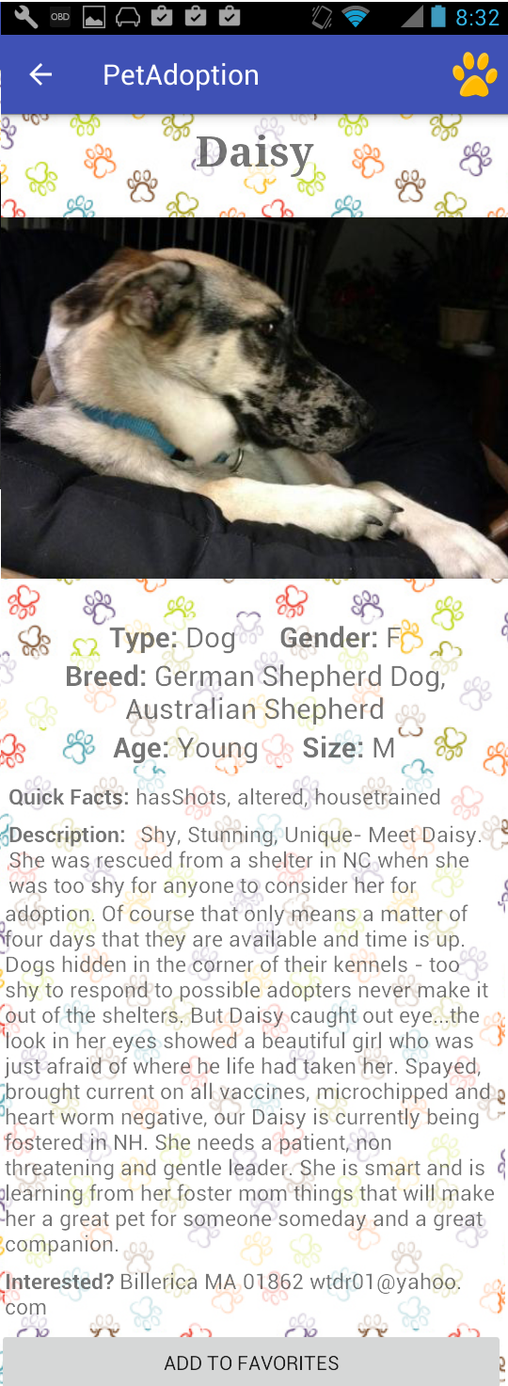
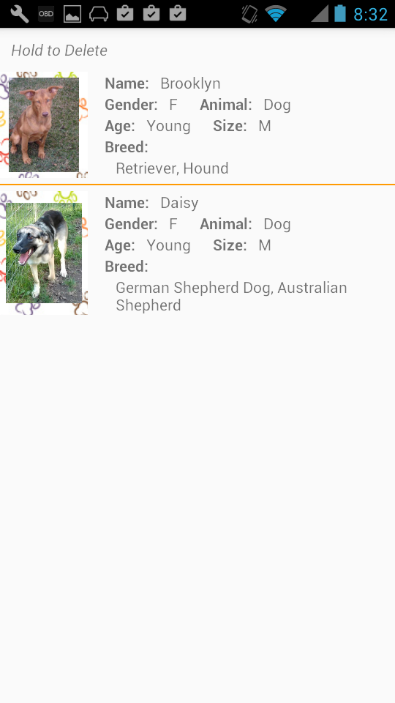
Project Design

Slide 5
File Structure
MainActivity – Gets location from user – Code by Daniel, Layout by Brianne
PetTypeActivity – Gets search options from user – Code by Daniel and Brianne, Layout by Brianne
PetListActivity – Show list of pet returned from search, start AsyncTask – Code by Daniel, Layout by Brianne
PetViewActivity –Show profile and pictures of selected pet – Code By Daniel and Brianne, Layout by Brianne
FavoritesActivity – Show list of pets added to favorites – Code by Scott, Layout by Scott and Brianne
Pets – Class to hold a single pets info – Code by Daniel
PetAdapter – Adapoter used to display pet list – Code by Daniel
FavoritesTable – Database to hold favorite pets info – Code by Scott
FavoritesContentProvider - - Code by Scott
PetAdoptionDatabaseHelper - - Code by Scott
PetCursorAdaptor - - Code by Scott
Utils – Network utilities to retrieve pets from API – Code by Daniel

Slide 6
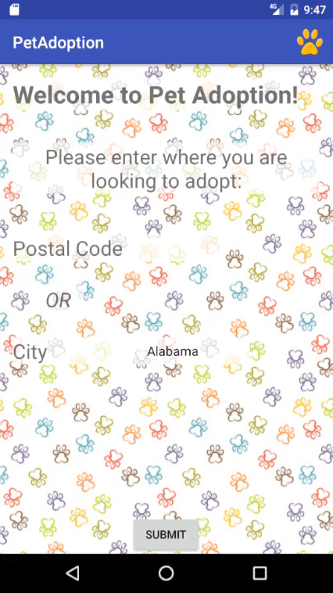
Video Demo

